Slide 1
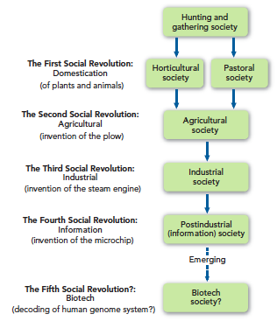
Societies—and Their Transformation
ca. 0.2 MYA
10000 BCE
6-5000 BCE
1765 CE
ca. 1950s CE
1953 or 2001 CE

