Slide 1
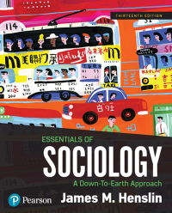
Chapter 8
Social Class in the United States

Slide 2
What is Social Class?
Definition: A large group of people who rank close to one another in property, prestige, and power.

Slide 3
What is Social Class?
Property: material possessions: animals, bank accounts, bonds, buildings, businesses, cars, machinery, jewelry, furniture, land, and stocks
  Distinction Between Wealth and Income
  Wealth: The total value of everything someone owns, minus the debts.
  Income: Money received, usually from a job, business, or assets.

Slide 4
What is Social Class?
  Distribution of Property: Ownership of property (real estate, stocks and bonds, and so on) is not distributed evenly: 10 percent of the nation’s families owns 75 percent of the wealth, and the wealthiest 1 percent of Americans own more than one-third of all assets in the United States.
  Distribution of Income: The top 20 percent of U.S. residents receive half (50.3 percent) of all the income in the United States; the bottom 20 percent receives 3.4 percent.

Slide 5
Distribution of the Property of Americans
© 2013 Pearson Education, Inc. All rights reserved.

Slide 6
The More Things Change, the More They Stay the Same: Dividing the Nation’s Income
Each one-fifth of the U.S. population receives approximately the same proportion of national income today as it did in 1935.
© 2013 Pearson Education, Inc. All rights reserved.

Slide 7
What is Social Class?
Power: The ability to get your way, despite resistance.
  “Democratic Façade”: An ideology promoted by the elites to legitimate and perpetuate their power.
  Power Elite: C. Wright Mills’ term to refer to those who make the big decisions in U.S. society. This group shares the same ideologies and values, belongs to the same clubs, and reinforces each other’s world view

Slide 8

In his 1956 publication entitled The Power Elite, Mills defined the "power elite" as consisting of a triumvirate of those individuals occupying the dominant positions in the dominant institutions (military, economic and political) of the U.S. The power elites decisions had enormous consequences, not only for the U.S. but the rest of the world’s population. The oligarchs comprising this elite can be generally grouped into one of six types:

Slide 9
the "Metropolitan 400" - members of historically notable local families in the principal American cities as represented in the Social Register
"Celebrities" - prominent entertainers and media personalities
the "Chief Executives" - presidents and CEOs of the most important companies within each industrial sector
the "Corporate Rich" - major landowners and corporate shareholders
the "Warlords" - senior military officers, most importantly the Joint Chiefs of Staff
the "Political Directorate" - "fifty-odd men of the executive branch" of the U.S. federal government, including the senior leadership in the Executive Office of the President, sometimes drawn from elected officials of the two major political parties, but usually professional government bureaucrats
Source: Wikipedia (“The Power Elite”, https://en.wikipedia.org/wiki/The_Power_Elite)

Slide 10
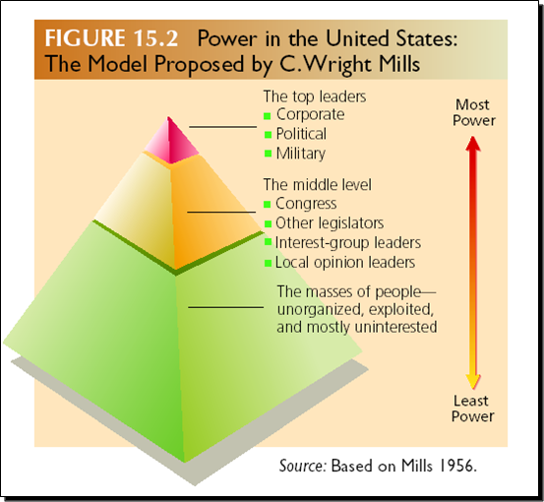
What is Social Class?

Slide 11
What is Social Class?
Prestige: Respect or regard.
  Occupations and Prestige: Occupations are the primary source of prestige. Highest prestige occupations:
    They Pay More
    They Require More Education
    They Entail More Abstract Thought
    They Offer Greater Autonomy
  Displaying Prestige

Slide 12
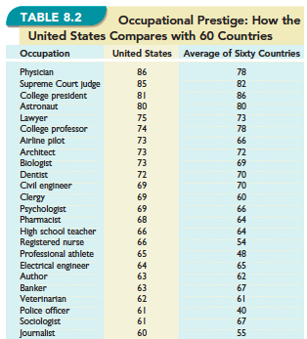

Slide 13
What is Social Class?
Status Consistent: Ranking high or low on all three dimensions of social class.
Status Inconsistency: Ranking high on some dimensions of social class and low on others.

Slide 14
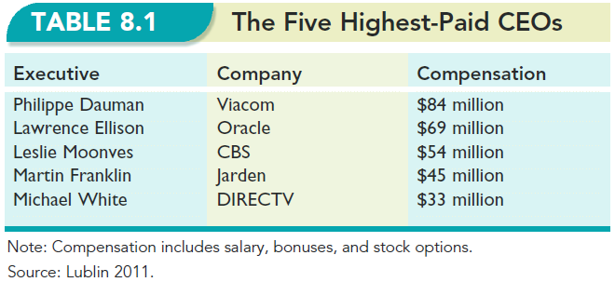

Slide 15
Marx’s Model of the Social Classes
© 2013 Pearson Education, Inc. All rights reserved.

Slide 16
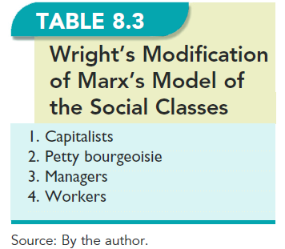

Slide 17
Sociological Models of Social Class
Updating Weber (Gilbert and Kahl)
  Capitalist Class
  The Upper Middle Class
  The Lower Middle Class
  The Working Class
  The Working Poor
  The Underclass

Slide 18
The U.S. Social Class Ladder
© 2013 Pearson Education, Inc. All rights reserved.

Slide 19
Consequences of Social Class
Physical Health
Mental Health
Family Life
  Choices of Husbands and Wives
  Divorce
  Child Rearing

Slide 20
Consequences of Social Class
Education
Religion
Politics
Crime and the Judicial System

Slide 21
Social Mobility
Intergenerational: The change that family members make in social class from one generation to the next.
Upward: Movement up the social class ladder.
Downward: Movement down the social class ladder.

Slide 22
Social Mobility
Structural: Movement up or down the social class ladder that is due to changes in the structure of society, not to individual efforts.
Exchange: About the same numbers of people moving up and down the social class ladder, such that, on balance, the social class system shows little change.
Women and Social Mobility

Slide 23
Poverty
Poverty line: Official measure of poverty; calculated to include incomes that are less than three times a low-cost food budget.
Who Are the Poor?
  The Geography of Poverty
  Race–Ethnicity
  Education
  The Feminization of Poverty
  Old Age

Slide 24
Patterns of Poverty
© 2013 Pearson Education, Inc. All rights reserved.

Slide 25
Race-Ethnicity and U.S. Poverty
© 2013 Pearson Education, Inc. All rights reserved.

Slide 26
Who Ends Up Poor? Poverty by Education and Race-Ethnicity
© 2013 Pearson Education, Inc. All rights reserved.

Slide 27
Poverty
  The Feminization of Poverty: Refers to the situation that most poor families in the U.S. are headed by women.

Slide 28
Births to Single Mothers
© 2013 Pearson Education, Inc. All rights reserved.

Slide 29
How Long Does Poverty Last?
© 2013 Pearson Education, Inc. All rights reserved.

Slide 30
Why are People Poor?
Social Structure
  Features of society deny some people access to education or training in job skills
Characteristics of individuals
Poverty triggers

Slide 31
Welfare Reform
Reforming Welfare
The Conflict View
Where Is Horatio Alger? The Social Functions of a Myth

Slide 32
Welfare Reform
Horatio Alger Myth: The belief that due to limitless possibilities anyone can get ahead if he or she tries hard enough.

